Slide 1
TEAM5OARS Online Apartment Rental System PRESENTATION Spring 2016
Online Apartment Rental System
Luis Silva, Anthony Cortes, Nixon Mathew, Kaisong Fan, Keith Russell, Sai Vadlamani, Visak Varghese

Slide 2
TEAM5OARS Online Apartment Rental System DATABASE BACK END
We are using MySQL Server to manage the database

Slide 3
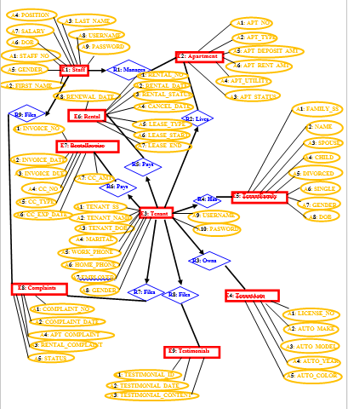
TEAM5OARS Online Apartment Rental System Data Analysis – ERD Model
#E: 9
#R: 9
#A: 50

Slide 4
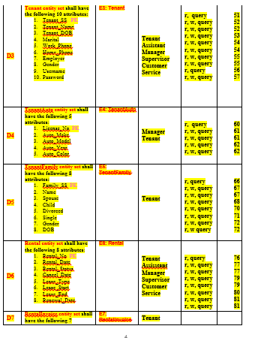
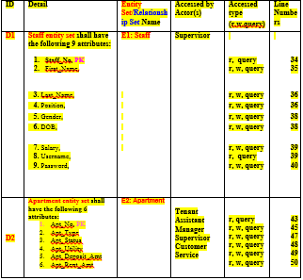
TEAM5OARS Online Apartment Rental System Contract – Data Requirements Specification
Table 1 Data Requirements

Slide 5
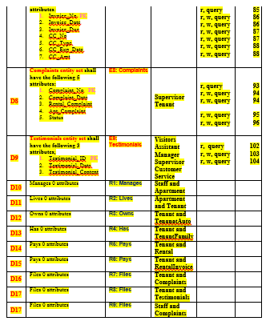
TEAM5OARS Online Apartment Rental System Contract – Data Requirements Specification
Table 1 – Continued

Slide 6
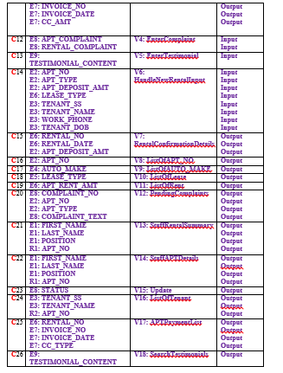
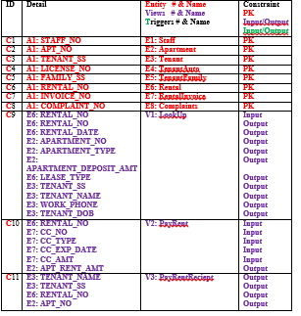
TEAM5OARS Online Apartment Rental System Contract – Data Requirements Specification
Table 2 - Constraints

Slide 7
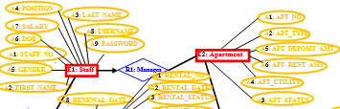
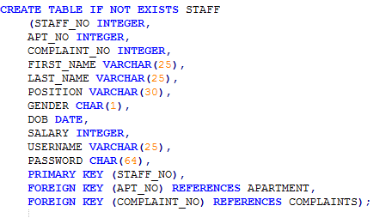
TEAM5OARS Online Apartment Rental System Data Design – Relational Model

Slide 8
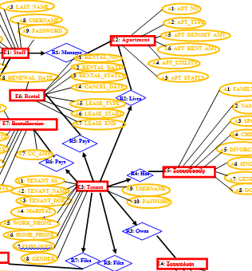
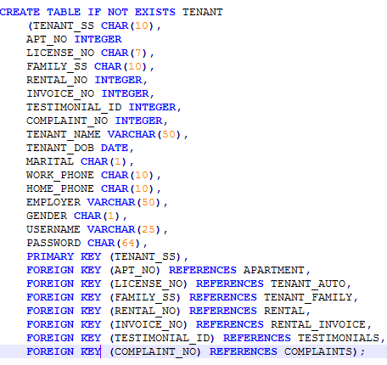
TEAM5OARS Online Apartment Rental System Data Design – Relational Model

Slide 9
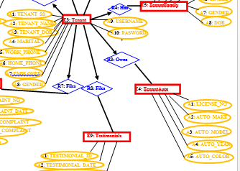
TEAM5OARS Online Apartment Rental System Data Design – Relational Model

Slide 10
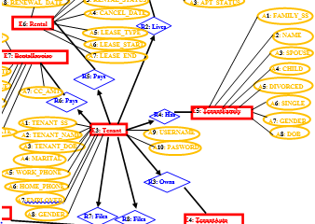
TEAM5OARS Online Apartment Rental System Data Design – Relational Model

Slide 11
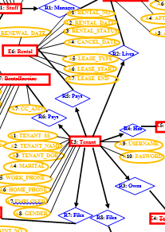
TEAM5OARS Online Apartment Rental System Data Design – Relational Model

Slide 12
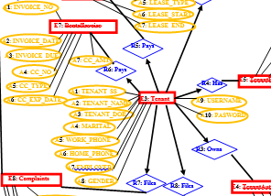
TEAM5OARS Online Apartment Rental System Data Design – Relational Model

Slide 13
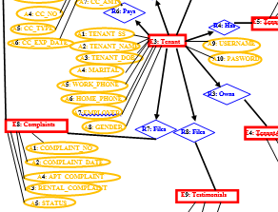
TEAM5OARS Online Apartment Rental System Data Design – Relational Model

Slide 14
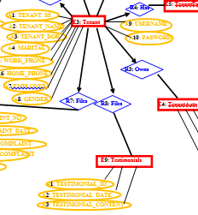
TEAM5OARS Online Apartment Rental System Data Design – Relational Model

Slide 15
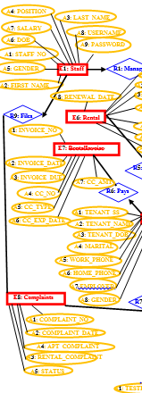
TEAM5OARS Online Apartment Rental System Data Design – Relational Model

Slide 16
TEAMOARS Online Apartment Rental System FRONT END
We’re using Zend Framework which is built on PHP.

Slide 17
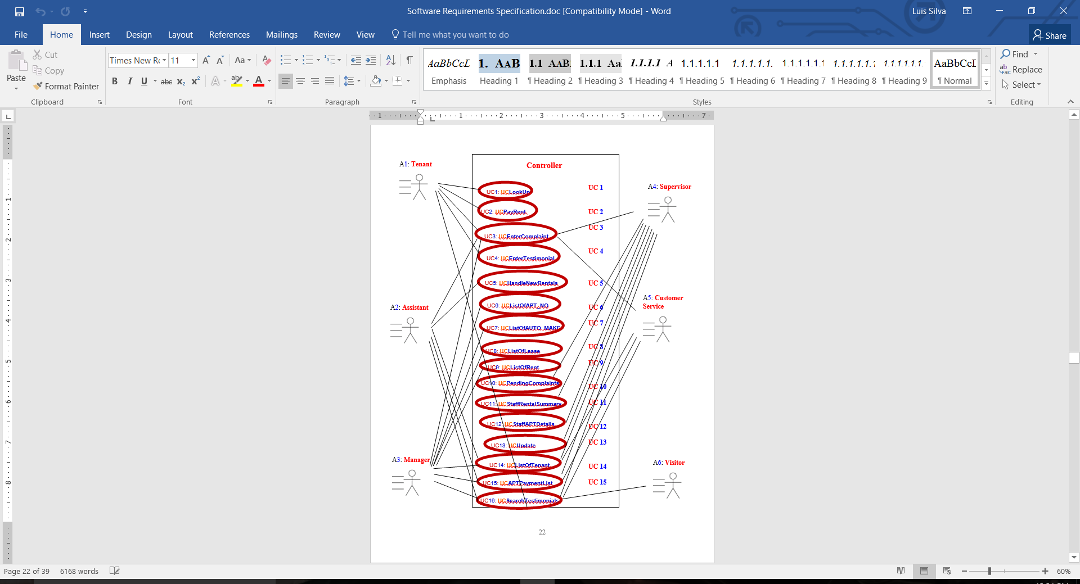
TEAM5OARS Online Apartment Rental System Business Modeling: UML USE CASE Model
Actors:6
Use Cases: 16
FRs: 16
NFRs:9
UML USE CASE Model

Slide 18
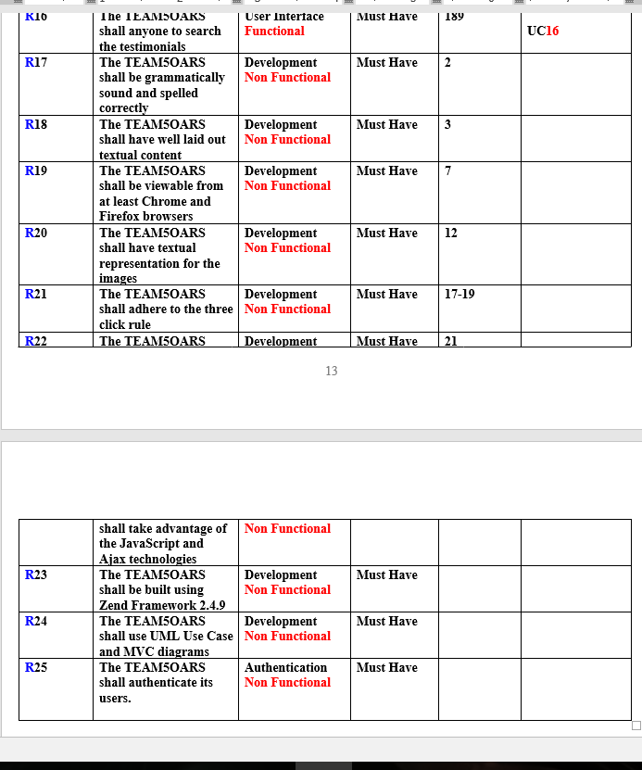
TEAM5OARS Online Apartment Rental System Contract: Software Requirements Specification
Summary of Ucs;
Table 3.2 Functional & Non-Functional Requirements;
Appendix with Actors and UML USE CASE Diagram.

Slide 19
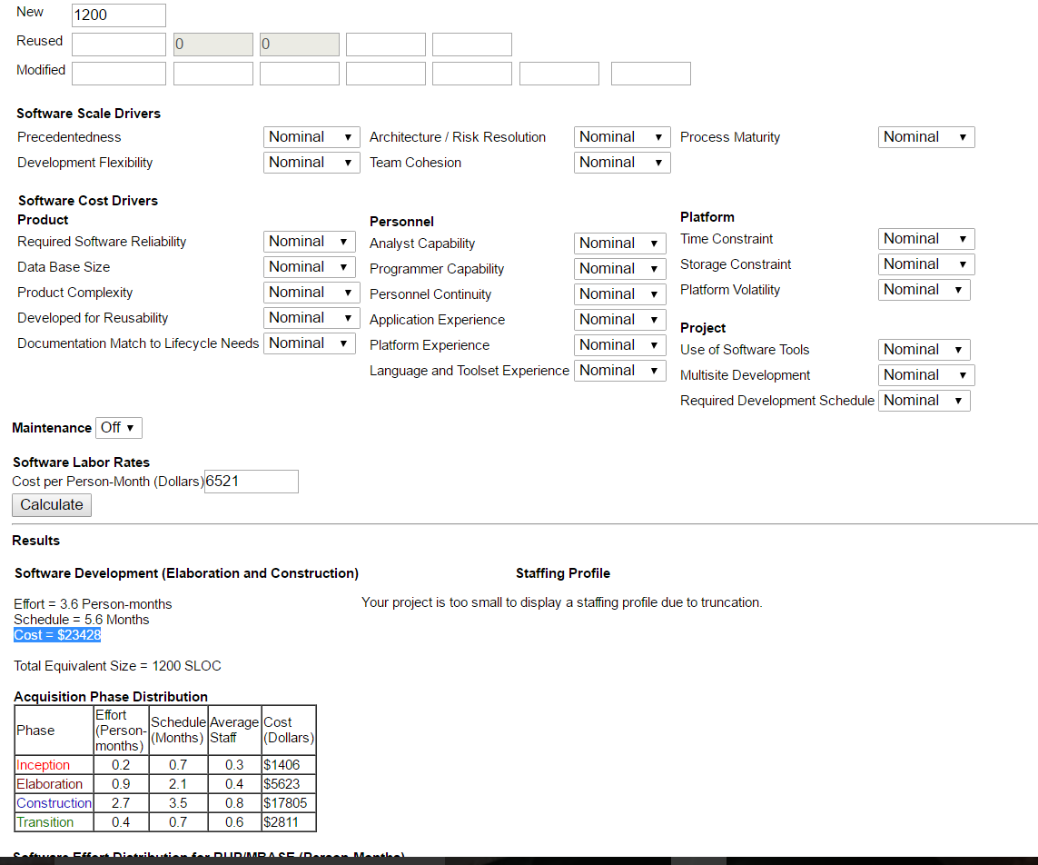
TEAM5OARS Online Apartment Rental System Software Project Management Plan
COCOMO II Estimates, screenshot of the CASE TOOL;

Slide 20
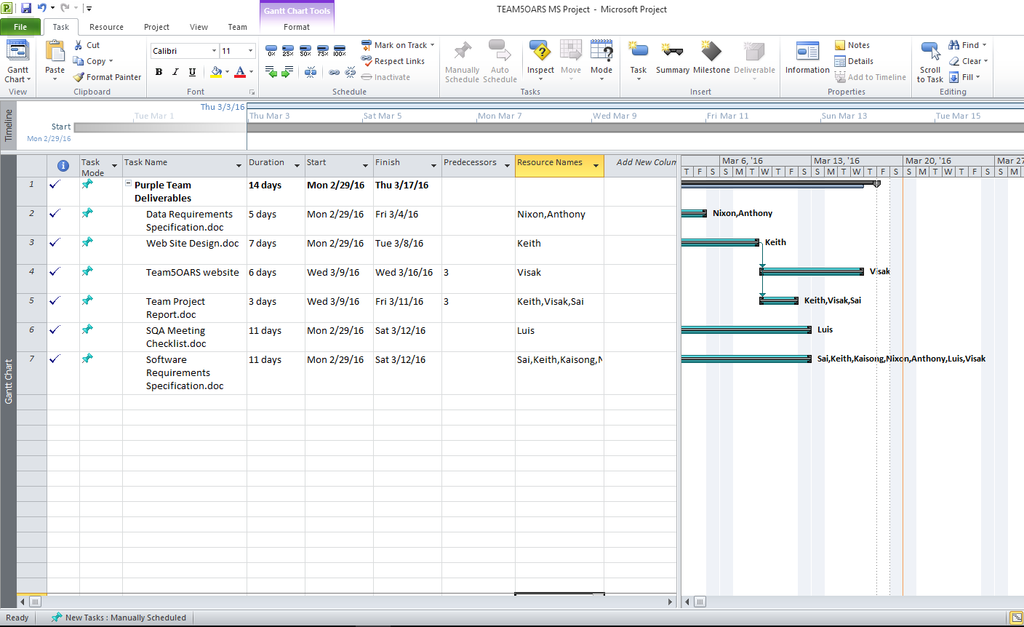
MS Project Plan

Slide 21
TEAM5OARS Online Apartment Rental System Chat Demo
Go to purechat.com > Sign up > Copy snippet code > paste before end of </body>
Live Chat demo.

